Slide 1

HI6050 Capstone: Comprehensive Topic Selection and Supplementary Document
Supervisor: Dr. Farshid Keivanian
Session 6: Preparation for Group Final Report

Slide 2
Group Presentations (Interim) & Meeting 2
(Meeting window: Wk 6–7) Objectives:
Conduct Meeting 2.
Deliver interim presentation on research progress.
Present updated literature review + draft methodology.

Slide 3
Group Presentations (Interim) & Meeting 2
Tasks for Groups:
Update literature review.
Present methodology draft & expected outcomes.
Receive peer and supervisor feedback.
Summarise literature review into 3–4 key insights and 1–2 research gaps.
Prepare slides that combine key literature findings with proposed approach.

Slide 4
Group Presentations (Interim) & Meeting 2
Literature Review Integration:
Link findings directly to your chosen methodology.
Show how literature influenced your research design.

Slide 5
Group Presentations (Interim) & Meeting 2
Do’s:
Practice presentation beforehand.
Bring evidence of research progress.
Don’ts:
Don’t read slides verbatim.
Avoid overcrowding slides with text.

Slide 6
Group Presentations (Interim) & Meeting 2
Supervisor Check Questions:
What changes did you make after Meeting 1 feedback?
How are you planning to collect and analyse data?

Slide 7
Preparation for Group Final Report
Word Count: 2500–3000 words Format: Microsoft Word (.docx only) | Holmes Harvard Referencing Submission Method: Blackboard (desktop/laptop only) Penalty: ❌ Students not listed on the cover sheet will receive zero marks

Slide 8
Preparation for Group Final Report
Purpose of the Report
The Group Final Report is a cumulative submission representing the research work, findings, and implications from your semester-long investigation. It showcases your ability to:
Frame a research problem
Conduct a literature-based inquiry
Present meaningful findings and recommendation

Slide 9
Preparation for Group Final Report
Weekly Breakdown – Section-by-Section Guide
Research Context
1. Abstract (100–250 words)
A concise summary of the whole report.
Include: the research problem, methods, major findings, and implications.
Tip: Write it last, but place it at the beginning.

Slide 10
Preparation for Group Final Report
2. Introduction
Include the following:
Background to the research area
Clear description of the problem
Significance of the research
Research question(s)
Project scope and limitations
Ethical considerations
Chosen research approach (qualitative – literature review)

Slide 11
Preparation for Group Final Report
Research Methods
3. Methodology
Use a qualitative approach (systematic literature review).
Follow guidance from Okoli & Schabram (2010).
Clearly describe:
What sources were searched?
What keywords or criteria were used?
Why was a literature review selected?
How was bias minimized?

Slide 12
Preparation for Group Final Report
Literature Review
4. Literature Review
Provide scholarly background to your topic.
Use relevant, peer-reviewed sources (journals, white papers, reports).
The review should:
Highlight existing gaps
Compare prior findings
Serve as evidence for your research direction
Reference:
Okoli & Schabram (2010), “A Guide to Conducting a Systematic Literature Review…”

Slide 13
Preparation for Group Final Report
Research Results & Conclusion
5. Results
Objectively present your findings from the literature.
Avoid interpretation or bias – just present the data/patterns/themes.

Slide 14
Preparation for Group Final Report
6. Discussion & Conclusion
In this section:
Interpret findings
Reflect on their significance
Compare to existing knowledge
Suggest improvements or policy/industry relevance
Offer future research directions

Slide 15
Preparation for Group Final Report
Final Report Submission
7. References
Use Holmes Adapted Harvard Style
Minimum of 10 scholarly sources recommended
All in-text citations must match the reference list

Slide 16
Preparation for Group Final Report
Final Document Includes:
Title Page + Cover Sheet (all team members listed)
Abstract
Introduction
Methodology
Literature Review
Results
Discussion & Conclusion
References

Slide 17
Preparation for Group Final Report
Formatting Requirements
MS Word (.docx) ONLY
Font: Calibri, size 11pt, no spacing
Margins: 2 cm on all sides
All group members must be listed on the cover sheet
Submit from desktop/laptop (no phones/tablets/Blackboard app)

Slide 18
Preparation for Group Final Report
What Will Be Rejected (Zero Mark & Academic Misconduct)
❌ No cover sheet ❌ Students not registered in your Blackboard group ❌ PDF, Pages, screenshots, or handwritten answers ❌ Submitting from smartphones ❌ Listing students who did not contribute ❌ AI-generated text without critical editing or citation ❌ Submissions from overseas IPs without permission

Slide 19
Preparation for Group Final Report
Tips for Success
Start Early: Break down the work into manageable chunks weekly.
Assign Roles: Research lead, editor, reference checker, Gantt chart creator.
Use a Literature Matrix: To track your readings.
Use Tools: Zotero, Mendeley, or EndNote for referencing.
Proofread Carefully: Spelling, flow, and formatting affect marks.
Book Drop-in Consultations: For feedback or clarification.

Slide 20
Preparation for Group Final Report
Submission Checklist
Abstract summarizes full research
Introduction outlines scope, problem, and approach
Methodology uses systematic literature review
Literature review uses 10+ scholarly sources
Results presented objectively
Discussion interprets findings in context
All citations are correct and listed in references
Final .docx submitted via Blackboard from PC/Mac
All team members listed on cover sheet

Slide 21
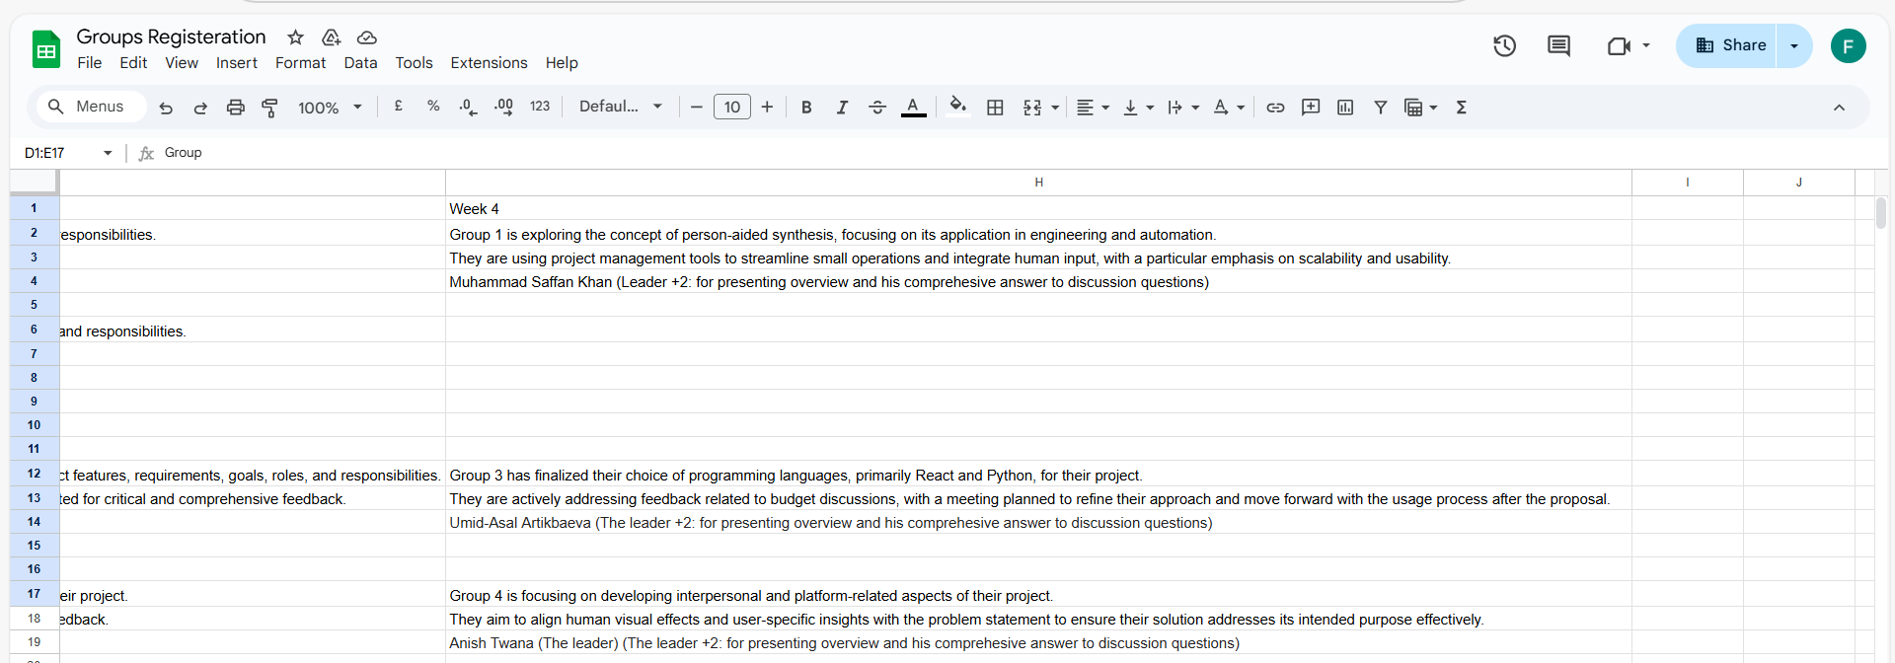
Group Progress Presentation – Overview of Progress at least 5 min

Slide 22
Thank You
Need Help? Send an email or ask during the tutorial session.
Good luck with your capstone journey!
Dr. Farshid Keivanian Capstone Project Supervisor FKeivanian@my.holmes.edu.au

